Slide 1

School of Electrical Engineering and Computer Science
Department of Electrical Engineering
EE-371 : Control Systems
Lecture#02
Introduction to Control Systems
Chapter #01
Text Book: Control Systems Engineering by Norman S. Nise 5th Edition
Instructor: Ms Neelma Naz
Class: BEE 12 C/D

Slide 2
Types of Control System
A system designed to follow a changing reference is called tracking control or servo.
A system designed to maintain an output fixed regardless of the disturbance present is called a regulating control or a regulator.

Slide 3
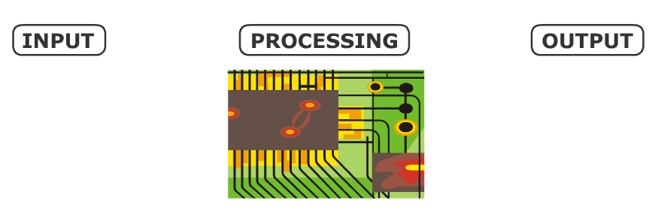
Parts of Control System
In their simplest form, control systems take in data as input, process the data, and then send out signals as output…

Slide 4
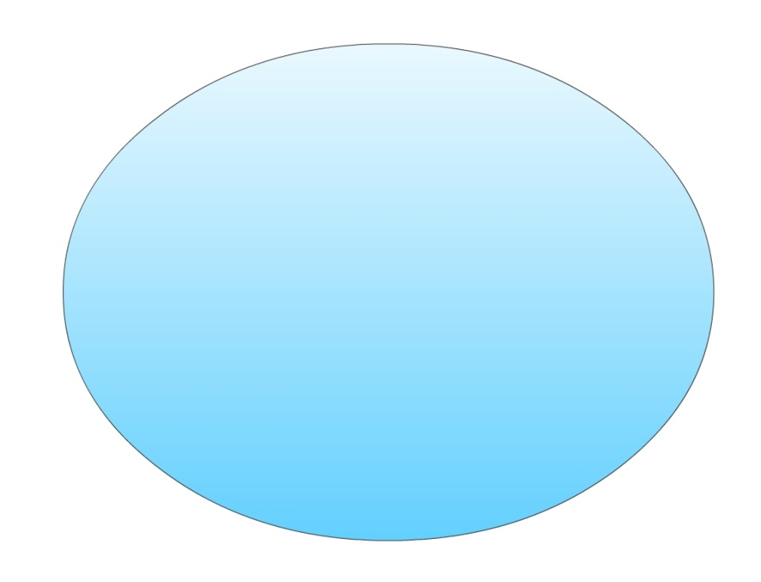
Types of Control System
There are two main types of control system…
Open Loop
System
&
Closed Loop
System

Slide 5
Open Loop System
The open loop system is the simplest type of control system, as it does not take account of the output. The input data is processed, then sent as output, e.g. an automatic door…
A person steps on a pressure pad, and the pressure pad sends a signal to the control box
The control box processes the data, and sends a signal to the electric door
The door opens in time for the person to walk through

Slide 6
Example of Open-Loop System i.e without Feedback
Students
Intake
Disturbance
Parties, Chit Chat
Games, TV, Net
(Controller)
NUST
Environment
Output
Result
(Actuator)
Teaching
Activities
NUST
(Plant)
Students
Yearly
Exam
Performance
For students in a College, a …???…..loop College environment is shown in a block diagram (system with NO REGULAR check (Feedback) on the students). If there are no quizzes, home assignments, midterm exams, we call that system as an …………………………… (Open Loop / Closed Loop ??)
6

Slide 7
Feedback
Feedback is a key tool that can be used to modify the behavior of a system.
This behavior altering effect of feedback is a key mechanism that control engineers exploit deliberately to achieve the objective of acting on a system to ensure that the desired performance specifications are achieved.
Notes:
Feedback is a very heart of control. Three examples are given for feedback systems in the book. Students are encouraged to read Section 1.2.

Slide 8
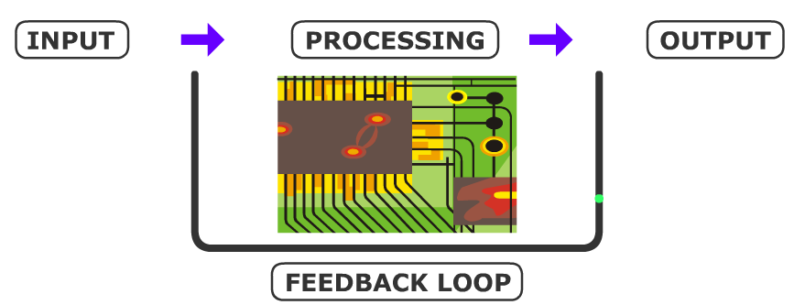
Closed Loop System
A closed loop system uses feedback provided by sensors. Feedback is where information from the output gets used as part of the input. A feedback loop provides extra data, which is processed with the input data.

Slide 9
Closed Loop System
Most control systems are closed loop systems. For example
Disturbance
Parties, Chit Chat
Games, TV, Net
Error
Controller
Reference
(Standard)
(Controller)
NUST
Environment
(Actuator)
Teaching
Activities
NUST
(Plant)
Students
Output
Result
+
-
(Sensor)
End & Mid,Terms
Quizes, Labs
Assignments
Notes:
For students in a College, a …???…… loop College environment is shown in a block diagram (system with regular check on the students). If there are no quizzes, home assignments, midterm exams, we call that system as
an …………………………….(Open/Closed loop)

Slide 10
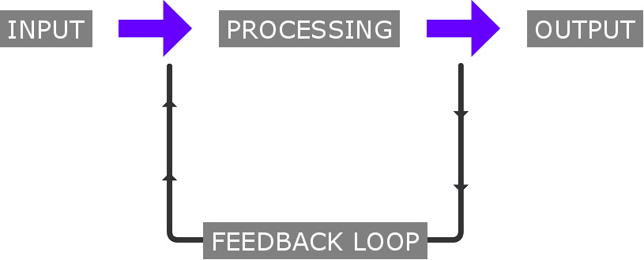
Flight Control System
The pilot operates the control to put the aircraft into a steep turn.
Feedback also forms part of the input.
The plane’s control box (a large computer) processes this data and sends signals to the wing flaps and engines.
The wing flaps and engines make the necessary adjustments.
Sensors monitor the tilt of the aircraft and send this information to the control box. This becomes part of the input. When the required amount of tilt has been reached, the computer sends signals to the wing flaps and engine to stop any further adjustments.

Slide 11
Human Body Example
Disturbance Forces
Desired
position
Output Position
Neural Signal
Muscle
Hand
G(s)
Control algorithm (Brain)
Actuator
Y(s)
R (s)
Controller
U (s)
Plant
Reference
Input
Control block
Eye
Sensor
Open loop
No Feedback
Closed loop
With Feedback
11

Slide 12
Multivariable Control System
Desired Output Response
Controller
Process
Output Variables
Measurement
Multi Input Multi Output (MIMO) System

Slide 13
Classification of Control Systems
Control Systems
Natural
Man-made
Manual
Automatic
LTI Control Systems(Linear time invariant control systems)
Open-loop
Closed-loop
Non-linear
linear
Non-linear
linear
Time variant
Time invariant
Time variant
Time invariant
13

Slide 14
What is the Control System Engineer trying to achieve? (Analysis and Design Objectives)
First, understand the broader picture of the
application to best apply a suitable control system.
A good control system is a system that will
generate a response quickly and without oscillation (good transient response),
have low error once settled (good steady-state response),
and will not oscillate wildly or damage that system (stability).

Slide 15
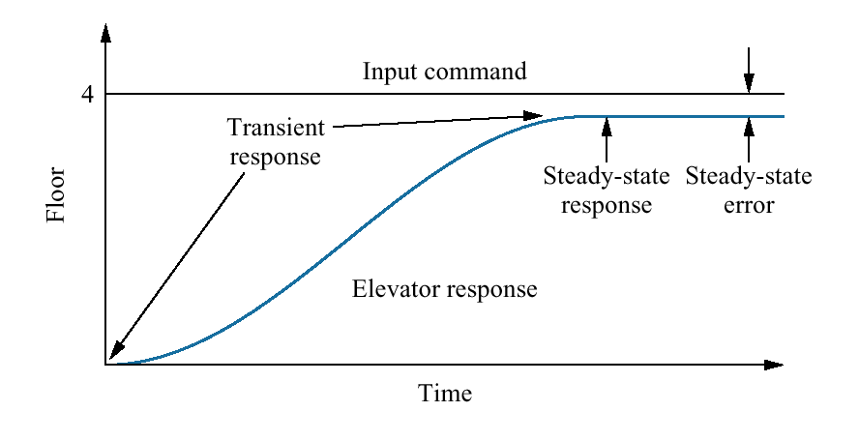
Control Systems (Example)
Consider an elevator. When the fourth-floor button is pressed, the elevator rises to the fourth floor with a speed and floor-leveling accuracy designed for passenger comfort.
Two measures of performance are :
(1) the transient response
(2) the steady-state error.
Passenger comfort and passenger patience are dependent upon the transient response
15

Slide 16
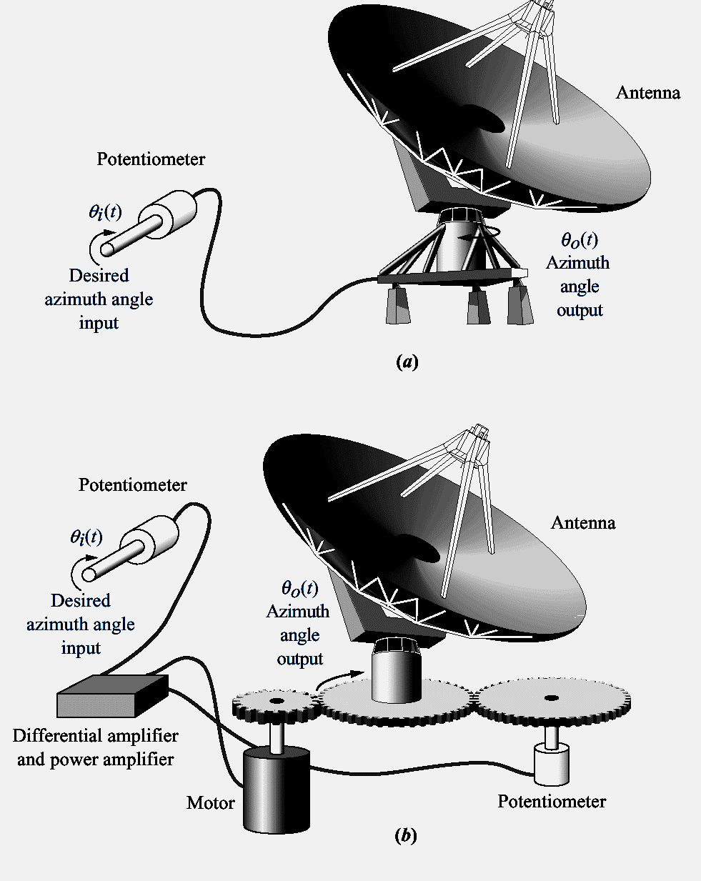
Antenna azimuth position control system:
system concept
detailed layout
16

Slide 17
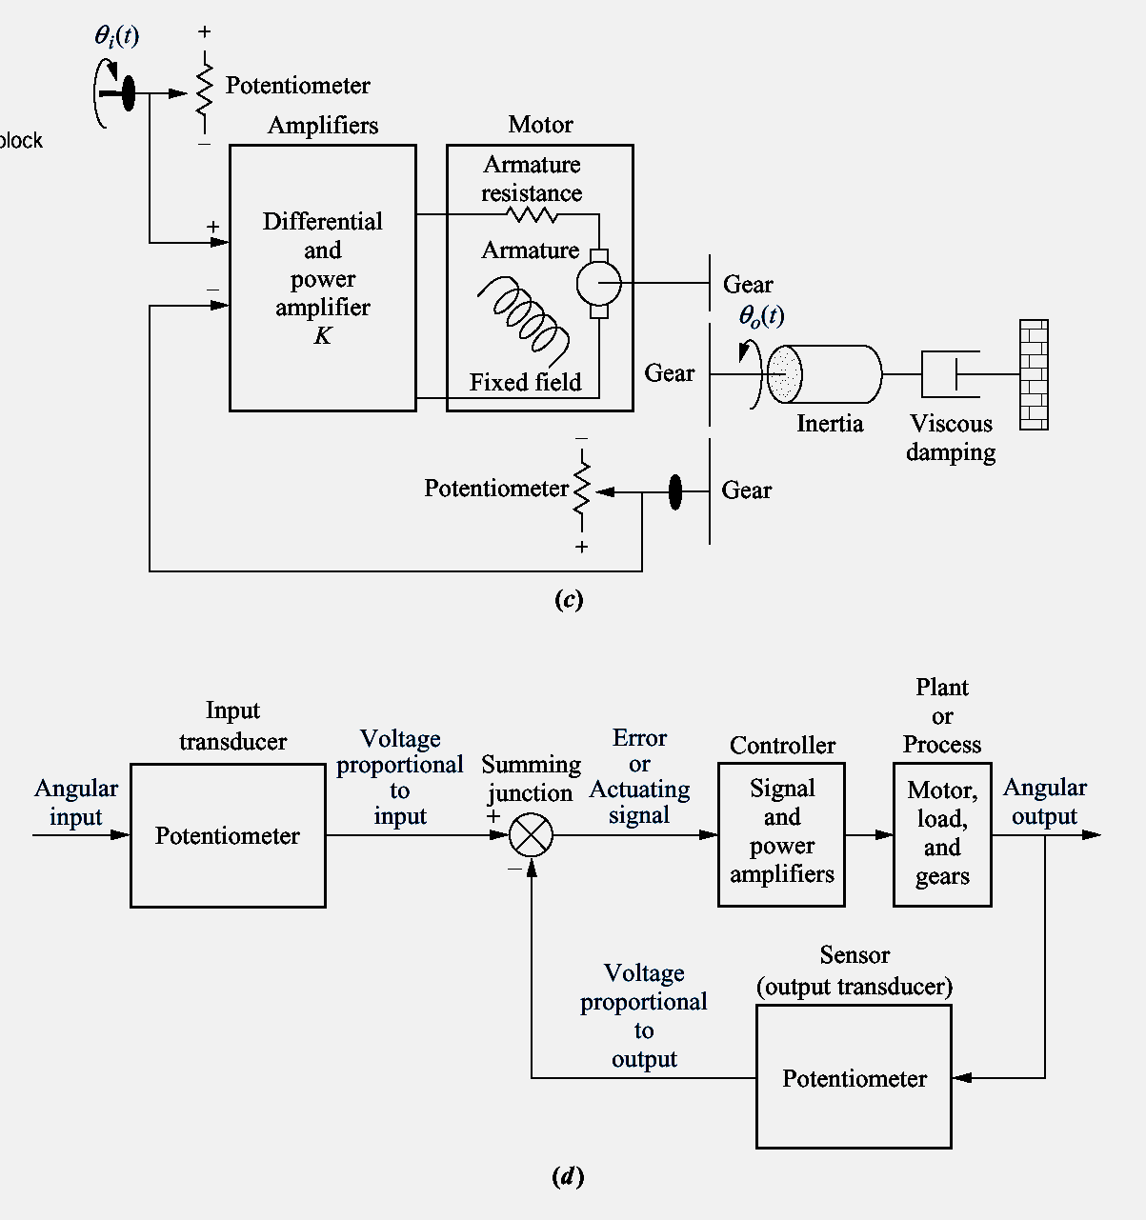
Antenna azimuth position control system:
Schematic diagram
functional block diagram
17

Slide 18
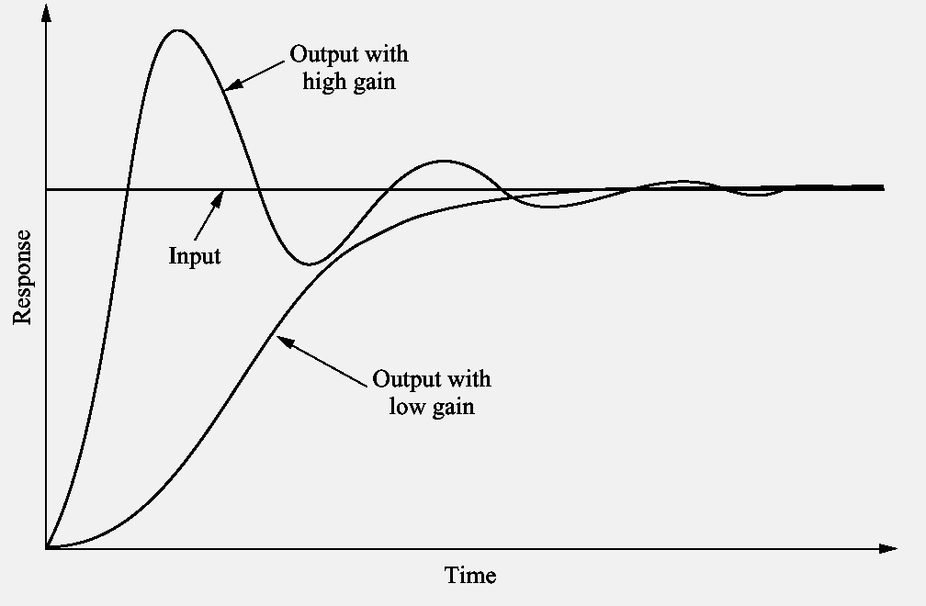
Response of a position control system showing effect of high and low controller gain on the output response

Slide 19
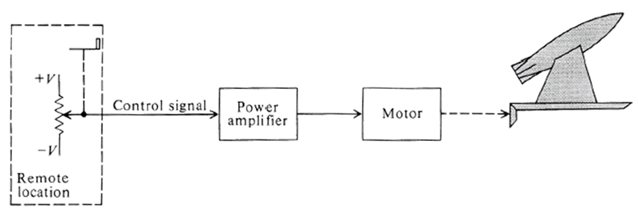
Control System Classification
Missile Launcher System
Open-Loop Control System

Slide 20
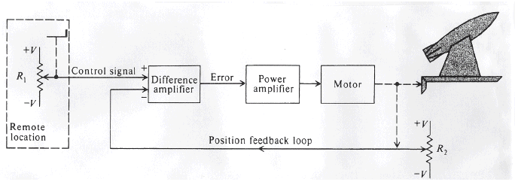
Control System Classification
Missile Launcher System
Closed-Loop Feedback Control System

Slide 21
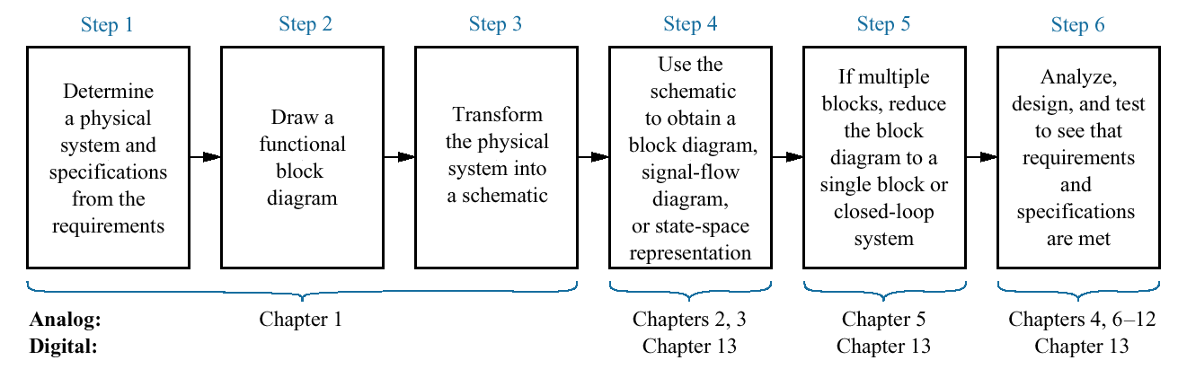
The control system design process
21

Slide 22
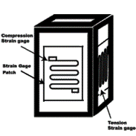
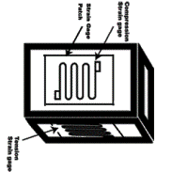
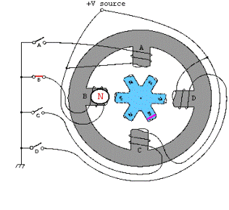
What is a Actuator?
Actuator is a device which converts energy from one form to another. e.g: microphone, thermometer, loud speaker, antenna and many more.
Complex
Electrical
Mechanical
Energy
Actuator
Motion
Linear
Thermal
Electro-Mechanical
Fluid
Hydraulic
Pneumatic
Rotary
Chemical

Slide 23
What is a sensor?
Sensors are transducers that produce (transform) electrical energy (signals) as a result of some type of stimulation (measurement space)
Temperature
Distance
Electrical Signals
Measurement
Sensor
Voltage
Voltage
Current
Digital
Force
Speed

